Slide 1
ARRAYS

Slide 2
ARRAYS
An array is a collection of data elements that are of the same type (e.g., a collection of integers, collection of characters, collection of doubles).
Element
Each item stored in an array is called an element.
Index
Each location of an element in an array has a numerical index which is used to identify the element.

Slide 3
TYPES OF ARRAY
The dimensionality of the array:
One dimensional (i.e. list of values ),
Two-dimension array (a matrix or a table), etc.

Slide 4
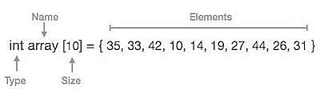
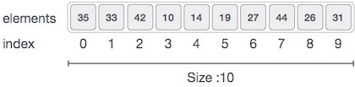
ARRAY

Slide 5
To declare an array in C++,
Syntax:
<type> <arrayName>[<array_size>];
The data type of the values which will be stored in the array
The name of the array (i.e. a C++ identifier that will be used to access and update the array values).
The size of each dimension
Examples
int x[10]; // An integer array named x with size 10
float GPA[30]; // An array to store the GPA for 30 students
int studentScores[30][5]; // A two-dimensional array to store the scores of 5 exams for 30 students

Slide 6
Basic Operations
Following are the basic operations supported by an array.
Traverse − print all the array elements one by one.
Insertion − add an element at given index.
Deletion − delete an element at given index.
Search − search an element using given index or by value.
Update − update an element at given index.

Slide 7
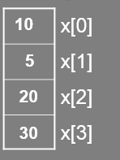
EXAMPLE
We use one-dimensional (ID) arrays to store and access list of data values in an easy way by giving these values a common name, e.g.
int x[4]; // all values are named x
x[0] = 10; // the 1st value is 10
x[1] = 5; // the 2nd value is 5
x[2] = 20; // the 3rd value is 20
x[3] = 30; // the 4th value is 30

Slide 8
OUTPUT OF ARRAY
Wrong way:
Int x[10];
cout << x;
Correct way:
int x[10];
// Displaying one value per line to the user:
for (int index=0; index<10; index++)
cout << x[index] << endl;

Slide 9
EXAMPLE
int aray[5];
cout << "Enter the value in array"<<endl;
for (int i = 0; i< 5; i++)
{
cin >> aray[i];
}

Slide 10
INPUT IN ARRAY
Wrong way:
Int x[10];
cin >> x;
Correct way:
int x[10];
// Reading one value at a time from the user:
for (int index=0; index<10; index++)
cin >> x[index];

Slide 11
EXAMPLE
Int aray[5];
cout << "the elements are :"<<endl;
for (int i = 0; i <= 5; i++)
{
cout << aray[i]<<endl;
}

Slide 12
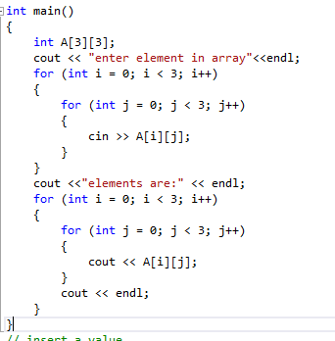
TWO DIMENSIONAL ARRAY

Slide 13
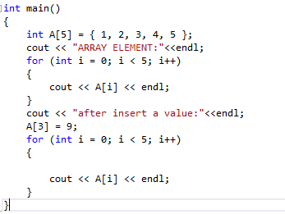
Update value

Slide 14
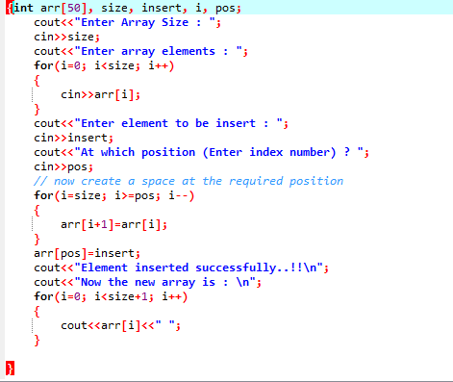
Insert value

Slide 15
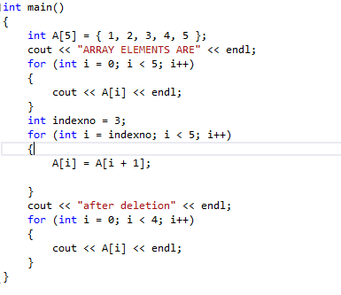
DELET A VALUE

Slide 16
LAB TASKS
Create an array of length 10 of integers. Values ranging from 1 to 50.
Find all pair of elements whose sum is 25.
Find the number of elements of A which are even, and the number of elements of A which are odd.
Write a procedure which finds the average of the value of A.
Write a procedure which adds an element in an array at a given index. Take the value to add and the index from the user.
Write a procedure which looks for 2 numbers 45 and 14 in an array and delete them if they are present in the array.

Slide 17
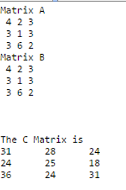

LAB TASK
2. Create a 2 dimensional Array. Translate the matrix multiplication algorithm into a program which finds the product C of an nxm matrix A and pxn matrix B. Test the program using
A=$\left[\begin{matrix}4 & 2 & 3 \\ 3 & 1 & 3 \\ 3 & 6 & 2\end{matrix}\right]$ B=$\left[\begin{matrix}2 & 4 & 5 & 9 \\ 3 & 2 & 8 & 7 \\ 8 & 4 & 3 & 2\end{matrix}\right]$
Out put:

